Slide 1


STANDING ON THE SHOULDERS OF
GIANTS
2.0

Slide 2





WHAT DO WE WANT TO LEARN?
3 KEY QUESTIONS
How does OOH work?
How effective are campaigns that use OOH versus those that do not?
How does OOH amplify other media?

Slide 3

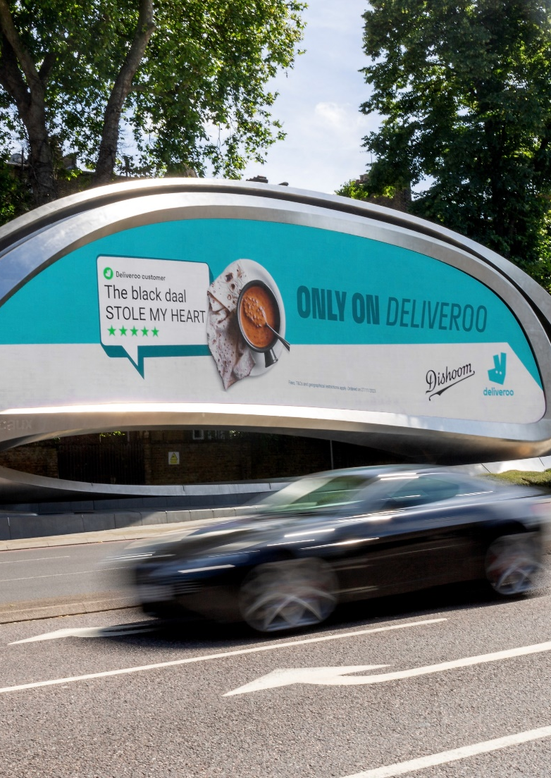




THE DATA
SOURCE
40+
2,000+
#1
years of advertising effectiveness
case studies
databank for extensive comparable data

Slide 4
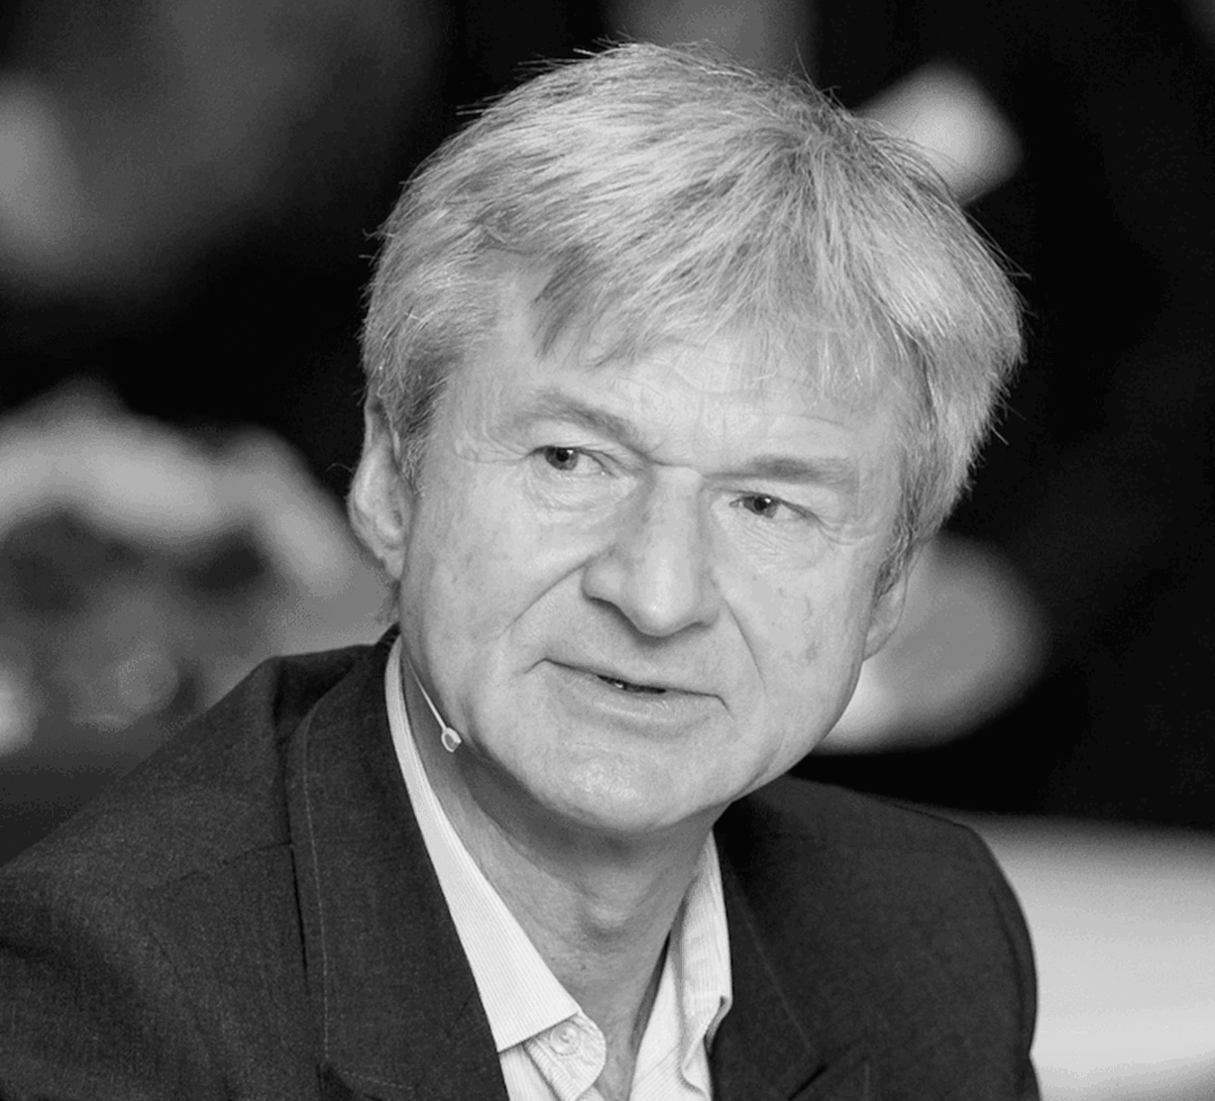
THE ANALYST
PETER
FIELD

Slide 5
METHODOLOGY: POWER-USERS VS NON-USERS
OOH POWER-USERS
15%+
41 CASES
Source: IPA Databank case studies 2014-2024

Slide 6
METHODOLOGY: POWER-USERS VS NON-USERS
OOH POWER-USERS
NON-USERS OF OOH
15%+
0%
41 CASES
41 CASES
Source: IPA Databank case studies 2014-2024

Slide 7
METHODOLOGY: POWER-USERS VS NON-USERS
OOH POWER-USERS
MUSH
NON-USERS OF OOH
15%+
1-14%
0%
41 CASES
41 CASES
Source: IPA Databank case studies 2014-2024

Slide 8
METHODOLOGY: POWER-USERS VS NON-USERS
OOH POWER-USERS
NON-USERS OF OOH
VS.
15%+
0%
41 CASES
41 CASES
Source: IPA Databank case studies 2014-2024

Slide 9
THERE HAS BEEN AN EXPLOSION IN THE NUMBER OF OOH POWER USERS
POST-COVID
Source: OOH Effectiveness IPA Databank Study

Slide 10
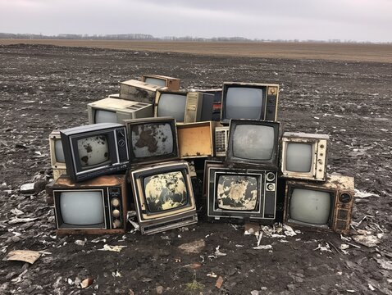
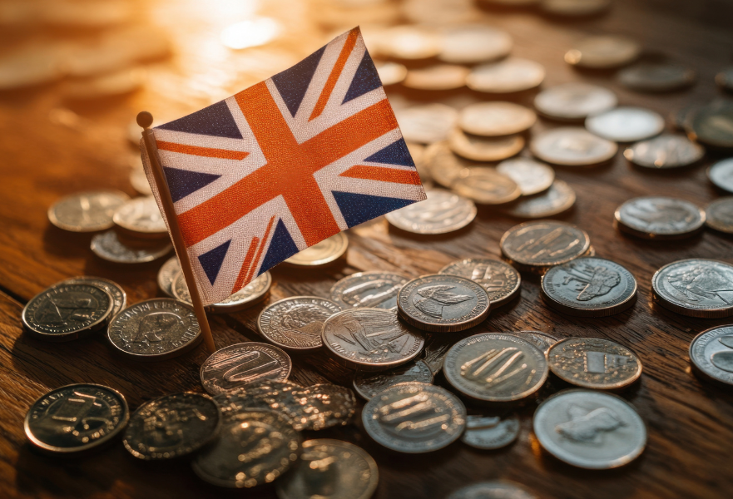
DISADVANTAGE FOR OOH
ADVANTAGE FOR OOH
CREATING A LEVEL PLAYING FIELD
Lower use of TV
More short-term cases
More service sector brands
Source: IPA Databank case studies 2014-2024

Slide 11
BOTH
SALES ACTIVATION
BRAND-BUILDING
HOW ARE THE MOST EFFECTIVE BRANDS USING OOH?
% of OOH spend
Source: IPA Databank case studies 2014-2024

Slide 12
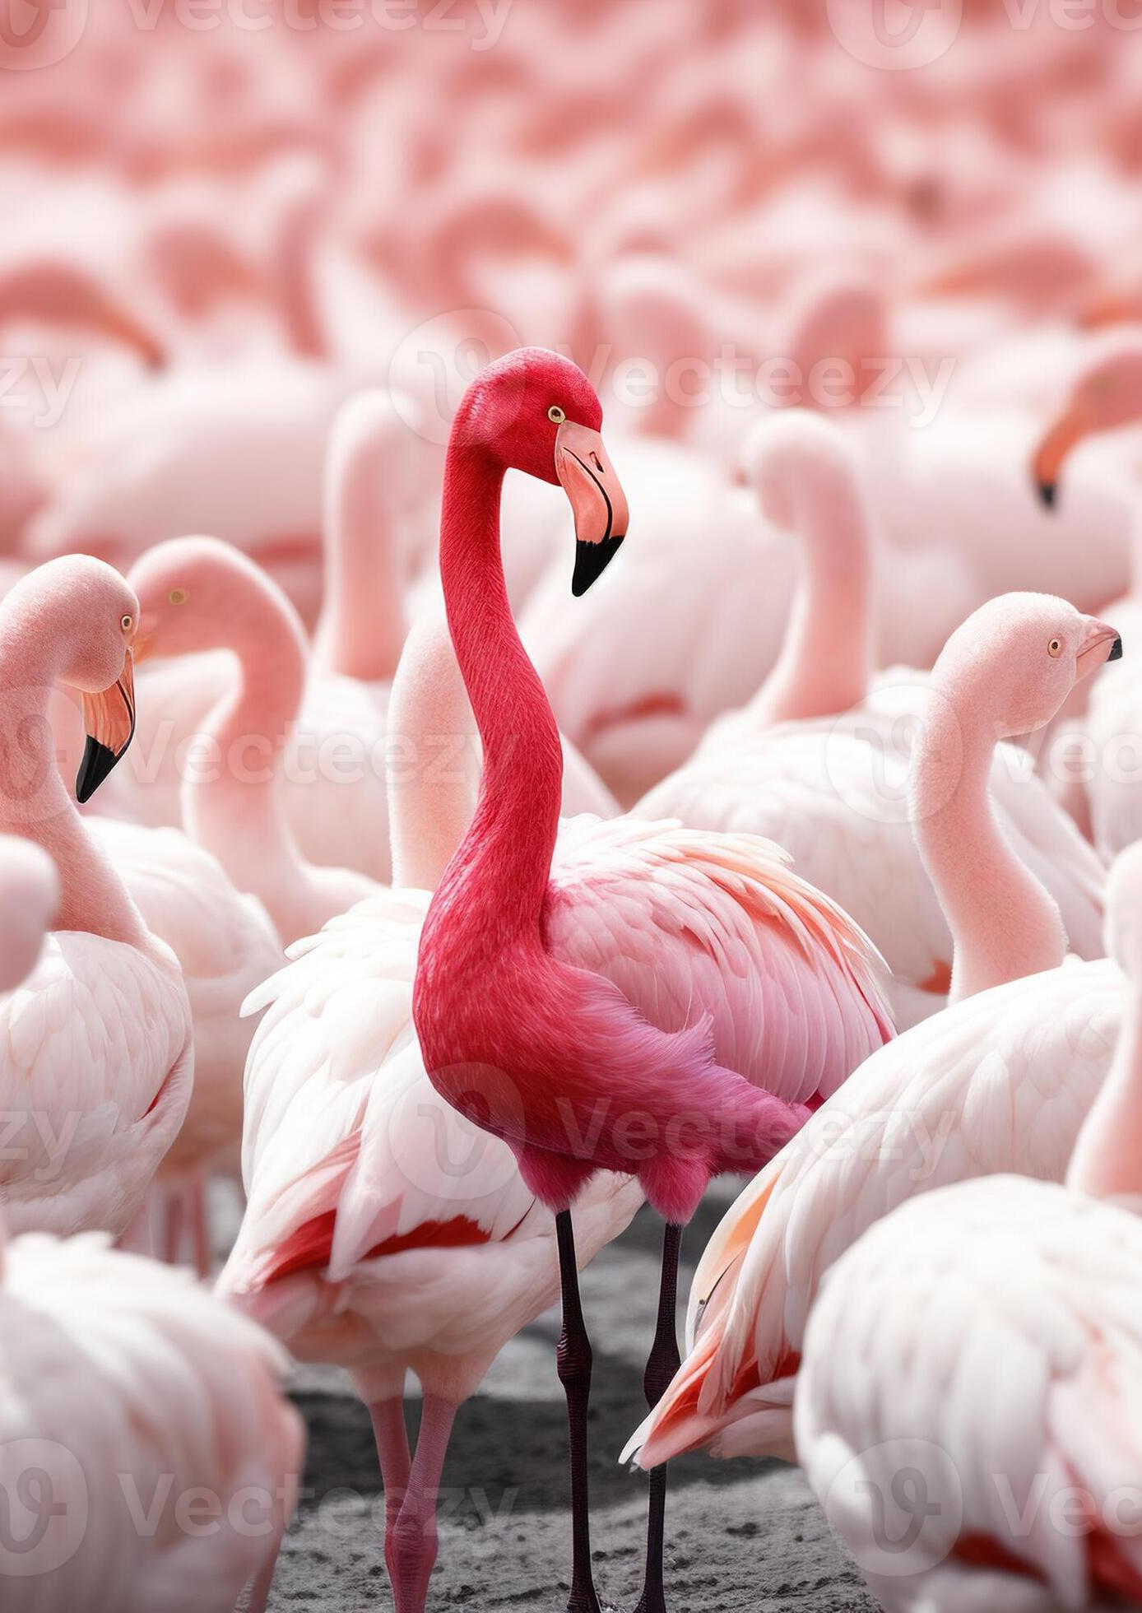


HOW DOES OOH WORK?
OOH MAKES BRANDS FAMOUS.
+40%
+50%
+89%
AWARENESS
ESTEEM
FAME
Source: IPA Databank case studies 2014-2024

Slide 13
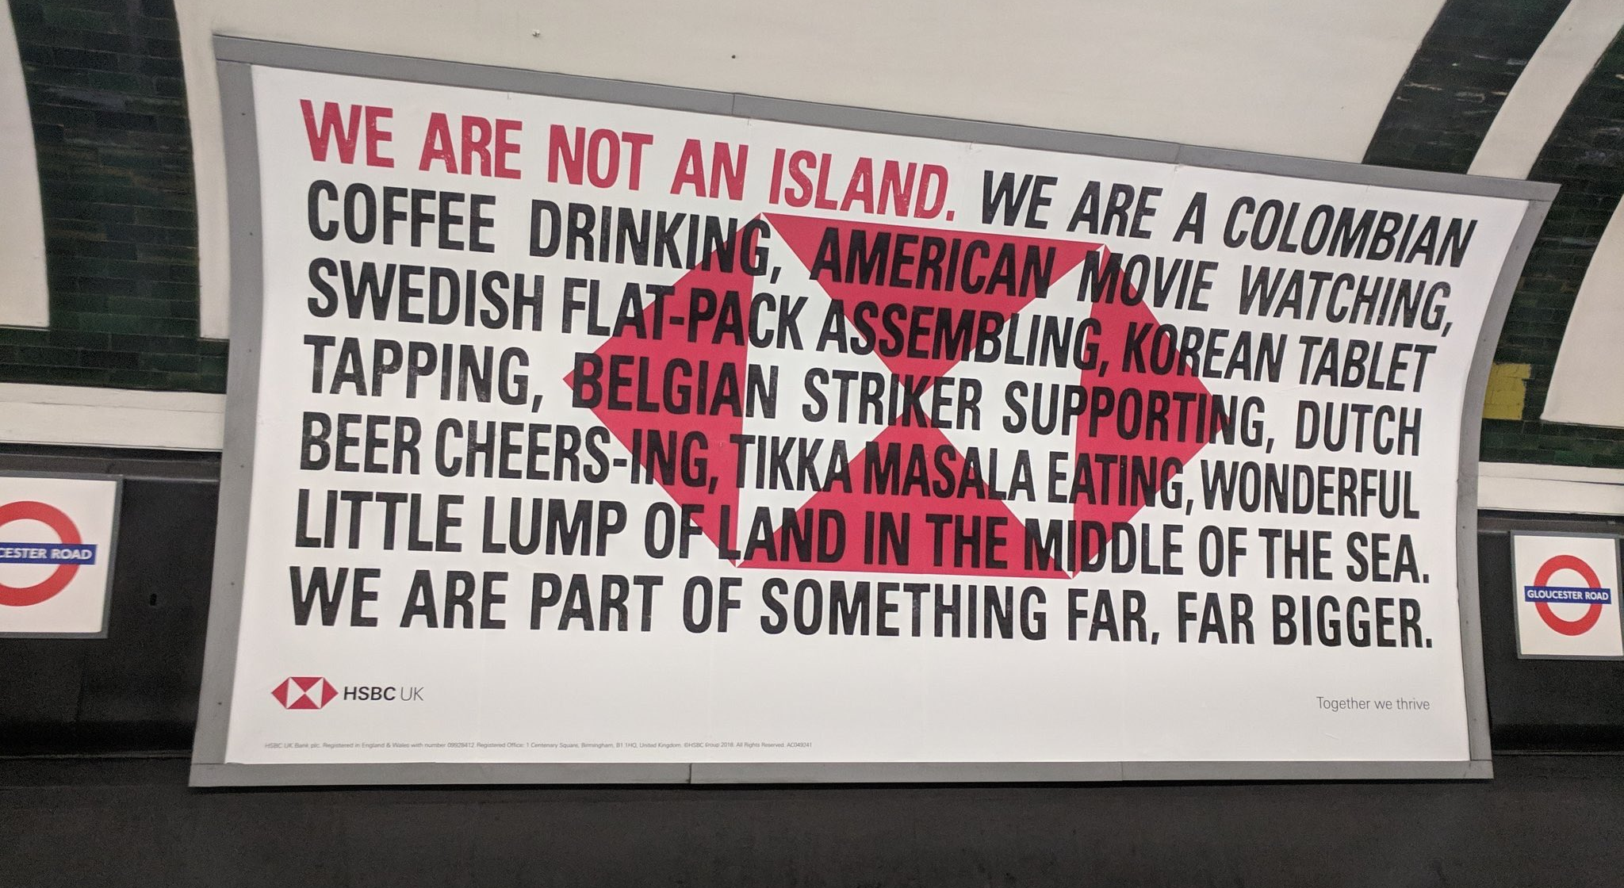
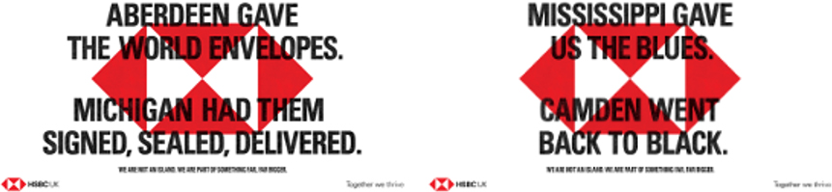
OOH CASE STUDY
HSBC
Change in business strategy meant HSBC could no longer claim to be the “World’s Local Bank”
Switch to more emotive product stories, but by 2017 key brand metrics including brand power were in decline
Champion the only distinctive brand asset – the red hexagon, making the logo 5x bigger
Contextual-relevant messages unique to the location complimented traditional broadcast formats
Successfully grew all attributes of brand power rising from 7th to 5th in rankings
Incremental revenue of £380m from 2019 to 2023
Notes:
For change in business strategy read financial crisis forced HSBC to close losing branches around the world, cutting operations in a number of market. While it was a powerful strapline which people associated with HSBC it was disingenuous to claim it any longer as it was no longer true.
THIS CHANGE OF STRATRGY FACILITATED A SWITCH TO MORE EMOTIVE PRODUCT STORIES, BUT BY 2017 KEY BRAND METRICS INCLUDING BRAND POWER WERE IN DECLINE. And consequently HSBC was loosing out to competitors. HSBC lagged behind the competition on Kantar's Brand Power score, stuck in 7th with a 3pt gap to 6th. The bank scored below the category average for all key drivers of Brand Power: 'Meaningful' (Affinity and Meets Needs), 'Different' (Innovative), and 'Salient' [4].
As we know from many of the ads we see and analyse in our creative testing tool ‘Visualise’ Logo size often causes feverish debate between agencies and clients. With the quickest way to antagonise a creative director “ asking him make the logo bigger".
However, in this instance there was no debate or arguing….
The red hex was HSBC UK's only distinctive asset. It needed to work as hard for the brand as possible.
So, HSBC upped the ante, scaling it up by 5x, making it the backdrop to all our advertising, giving instant standout and recognition.
You can probably recall the ads as they were very timely given it coincided with Brexit and the arguments surrounding the benefits of remaining vs leaving. Increasing it’s impact and helping to create a clear point of difference vs. its competitors in what is often a functional rather than emotive financial category.
The change in approach worked. HSBC UK grew all attributes of Brand Power, rising from 7th to 5th in the rankings.
Meaningful (+14pts v.s. 2017), Different (+19pts v.s. 2017) and Salient (+5pts v.s. 2017)
Also drove business results, generating over £380m in incremental profit from 2019 to 2023

Slide 14
HOW EFFECTIVE IS OOH?
OOH POWER-USERS DELIVER STRONGER LONG-TERM BUSINESS RESULTS
Source: IPA Databank case studies 2014-2024

Slide 15
HOW EFFECTIVE IS OOH?
OOH POWER-USERS DELIVER STRONGER LONG-TERM BUSINESS RESULTS
Source: IPA Databank case studies 2014-2024

Slide 16
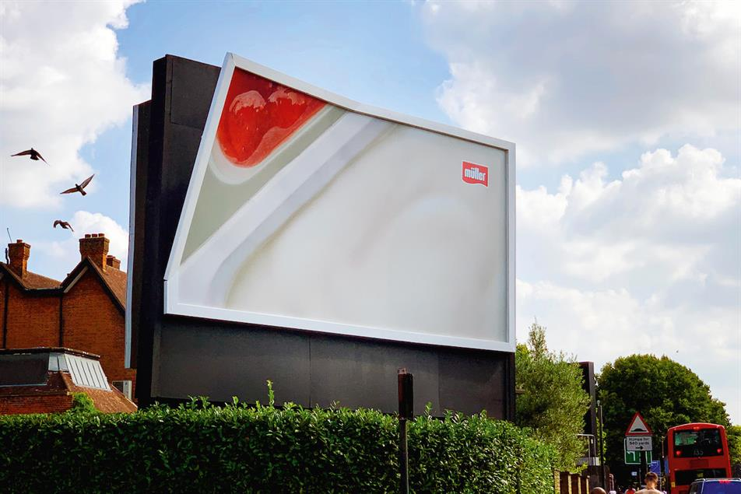
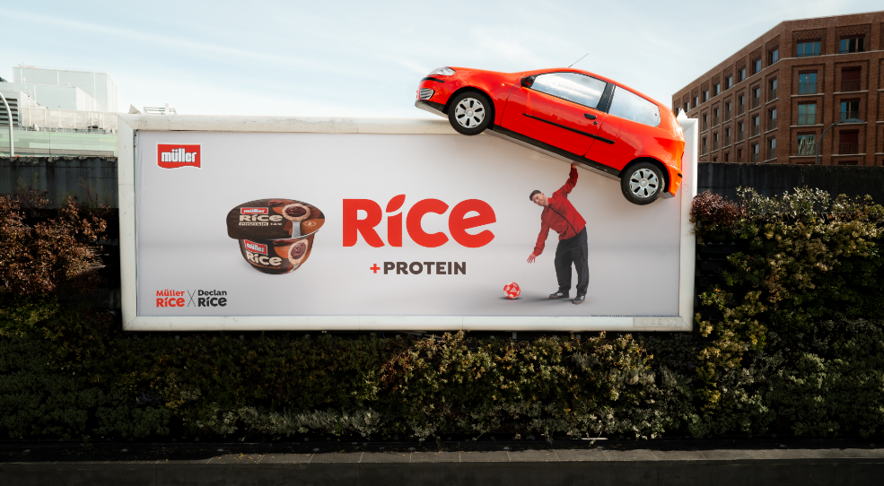
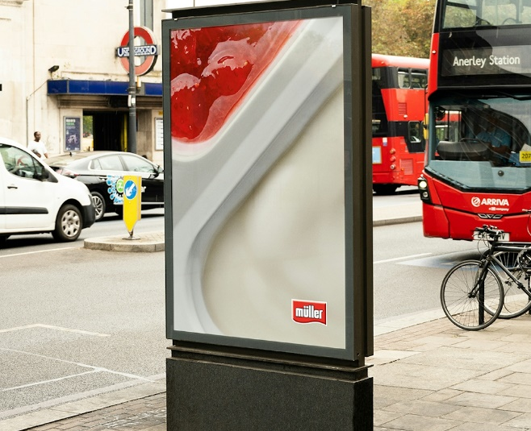
OOH CASE STUDY
MULLER
20% fewer households buying Muller
Loss of £6m in 2022 alone
New entrants stealing market share + desire for healthier products
542 failed products
But people still loved the product... Nostalgic, indulgent, sustaining
Muller Corner reversed 21 ppt decline, returning to growth for volume, value and share.
£56m incremental revenue across Muller brand
Notes:
At it’s peak in late 00s (2008) Muller penetration levels welose2021 this had shrunk to 56%. And it was forecast to drop to 44% by 2025 if action wasn;t taken.
In 2022 alone they lost 6m in revenue.
So what had changed for them to lose, 20% of their customer base?
New entrants - Onken, Alpro, Arla, Yeo etc… started stealing market share.
And Muller were under the impression that in order to keep up they needed to be healthier.
Launched a series of misguided and ultimately unsuccessful NPD in an attempt to keep up and regain market share.
Didn’t work so conducted a series of ethnographic video research diaries to understand what people loved about the brand.
Despite declining market share, people still loved the brand, was a whole thing on how people liked their yoghurt pot and how shopping and feeding kids Muller reminded them of their own childhood.
So media and in particular OOH activations was all about bringing that to life.
I think the special build with the corner peeling off is a fantastic use of an OOH special build leaning in to the media to convey and bring your message.
Not just Muller Corner that saw growth all the major brands including Rice, Light, Frijj all saw sales growth and market share return

Slide 17
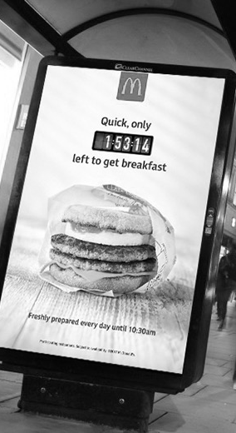
HOW EFFECTIVE IS OOH?
OOH POWER-USE BOOSTS SHORT-TERM SALES
+25%
UPLIFT IN SALES ACTIVATION EFFECTS VS. NON-USERS
Source: IPA Databank case studies 2014-2024

Slide 18
HOW EFFECTIVE IS OOH?
MAXIMISE SHORT-TERM SALES WITH SALES ACTIVATION MESSAGES
Source: IPA Databank case studies 2014-2024; based on very large sales activation metric

Slide 19
BRAND METRICS
BUSINESS METRICS
BEST PRACTICE IN OOH
BRAND + SALES ACTIVATION DOUBLES LONG-TERM RESULTS
1.87
Source: IPA Databank case studies 2014-2024; based on very large uplifts

Slide 20
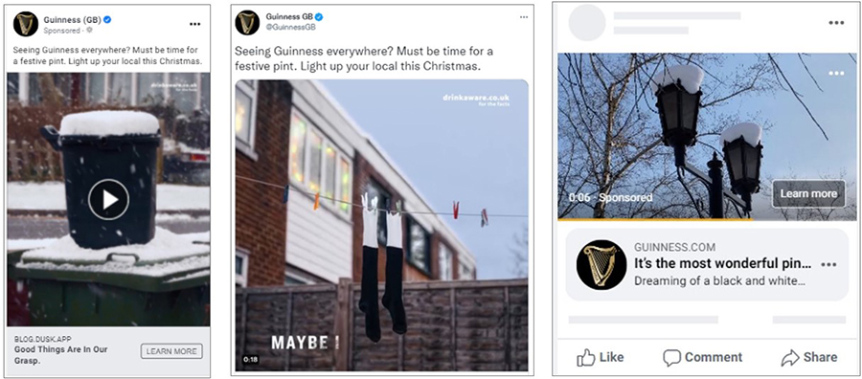
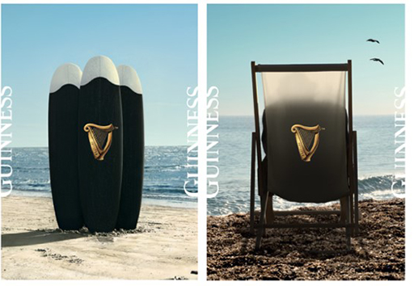
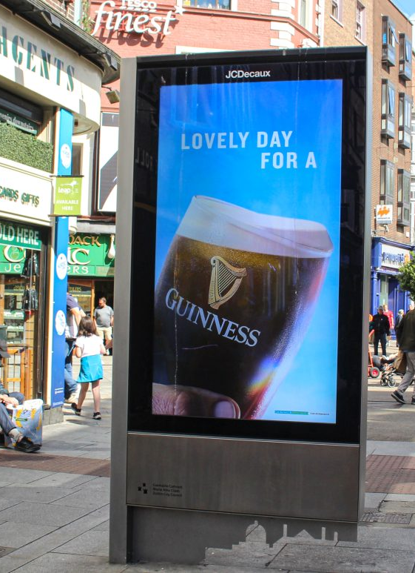
OOH CASE STUDY
GUINNESS
Sales peaked around key seasonal moments
More dependent than other brands on on-trade sales
Tapped in to social media conversations and brought them to larger audience via ooh
Dynamically trggered dooh messaging linked to weather & moment
Market share growth culminating in guinness becoming #1 beer on-trade beer in gb for first time
Strength of brand campaigns allowed guinness to increase price, while still seeing volume increases.
Notes:
This case study actually won gold at the awards – so amongst a series of great case studies this one even elevated above those.
Often when we think about Guinness we remember all the great ads, and its often upheld as best in class.
However, even Guinness wasn’t without it’s challenges and obstacles.
Sales tended to peak around key seasonal moments (Six Nations, St Patrick's Day & Christmas) with a big drop in the summer. Ad spend also reflected these ebbs and flows.
More dependent on-trade sales. A problem that was magnified by Covid and the fact pubs were shut for long periods of time. In fact Ireland had the longest shut down in Europe for pubs
Guinness needed to open the brand to more people and on more occasions.
How did they do that, tapped into some really nice cultural insights observed across social media platforms. Favourite and most distinctive was people taking and sharing pictures of every day objects that look like a pint of Guinness from a wheelie bin covered in snow to football socks hanging on the washing line. Prompted a feeling of longing as people couldn’t wait for pubs to open and to have that first pint of Guinness again.
This was brought to live via OOH, doing what Guinness do best using really simple, bold and distinctive assets, showcasing every day summer items that looked like a Guinness to bring the social conversation to a wider audience.
For added impact, DOOH ads played out at key seasonal moments linked to weather targets.
Became number 1 beer in UK for first time.
Also a great example of how investment in growing and strengthening the brand allows you to not only sell more of your product, but do so while increasing it’s value/price, which is not only growing your market share but it’s profitability too.
Really the perfect advocate of Binet & Fields works. Brand Building delivers greater business dividends over the long term by conveying value/service of the brand rather than devaluing it like more sales focused activations can. Also great example of how combining brand & sales messaging drives maximum effect.

Slide 21




HOW DOES OOH AMPLIFY OTHER MEDIA
OOH BOOSTS BUSINESS EFFECTS OF ALL CHANNELS
Source: IPA Databank case studies 2014-2024

Slide 22
BUSINESS EFFECTS
SALES
PROFIT
MARKET SHARE
28%
28%
8%
Source: IPA Databank case studies 2014-2024

Slide 23
BRAND EFFECTS
AWARENESS
FAME
58%
Source: IPA Databank case studies 2014-2024

Slide 24
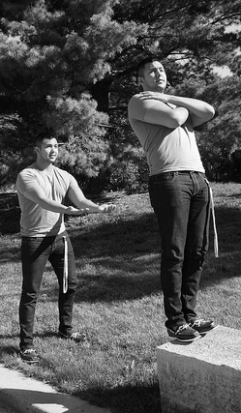
THE PUBLIC NATURE OF OOH MAKES ONLINE VIDEO ADVERTISING MORE TRUSTWORTHY
+215%
TRUST
Source: IPA Databank case studies 2014-2024

Slide 25
WHAT DID WE WANT TO LEARN?
3 KEY QUESTIONS
How does OOH work?
How effective are campaigns that use OOH versus those that do not?
How does OOH amplify other media?

Slide 26
WHAT DID WE LEARN?
3 KEY ANSWERS
OOH adds stature & fame to campaigns
OOH power-users are more effective at delivering business outcomes
OOH boosts the business effects of all other media - especially social & video formats

Slide 27
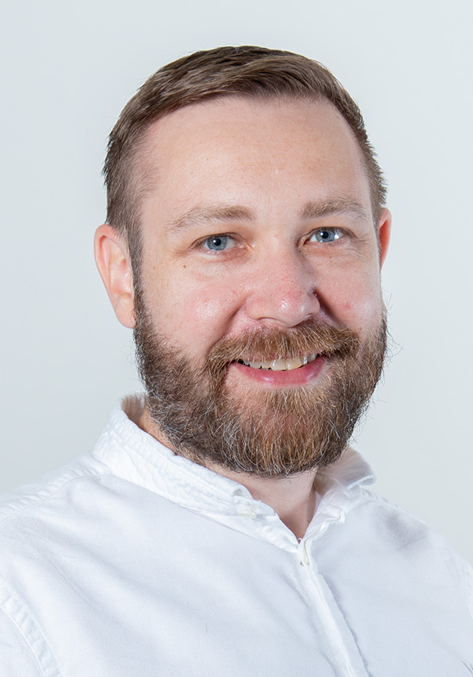
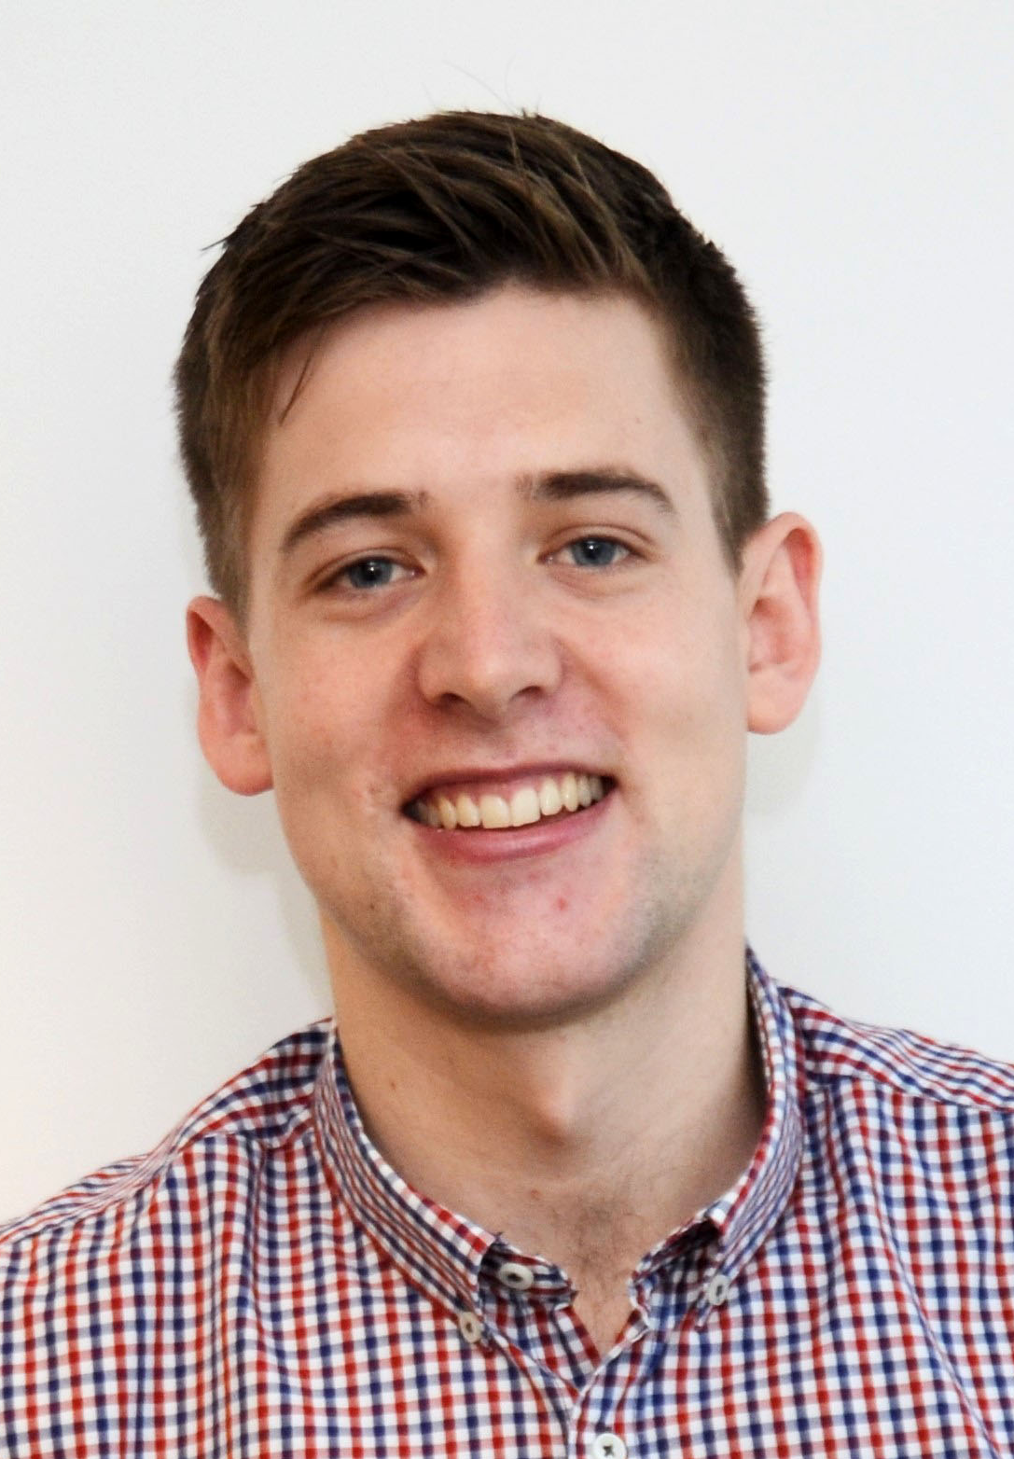
Q&A
PAUL SAMBROOK
GLOBAL HEAD OF STRATEGY & GROWTH
paul.sambrook@rapportww.com
ROSS WILSON
HEAD OF INSIGHT, EMEA
ross.wilson@rapportww.com

